Slide 1

CAPSTONE1
University Reviews
Group: C1SE 04 2020

Slide 2

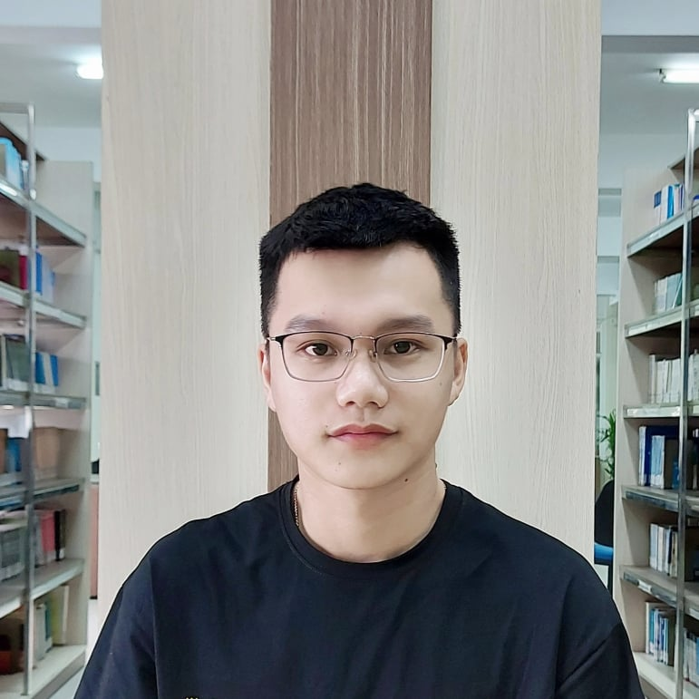
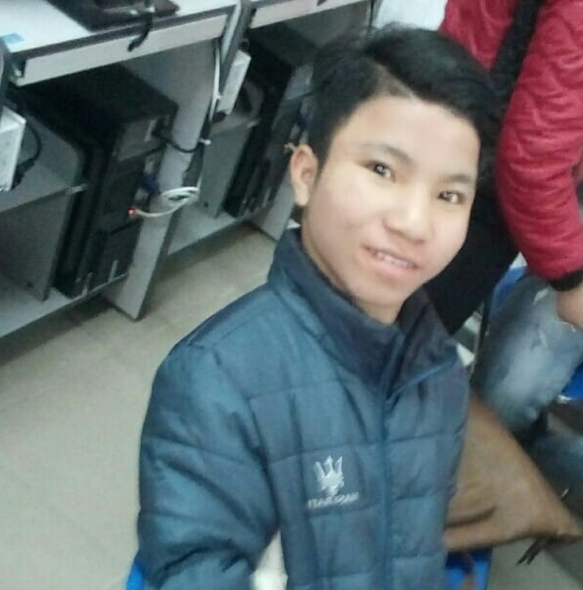

NGUYEN VAN MINH TOI Product Owner
NGUYEN HUU THIEN Mester scrum
HO XUAN SANG Developer
HUYNH THI QUY THUONG Developer
CAPSTONE1
Members of team

Slide 3

Introduction to Mentor
CAPSTONE1
Dr. Ha Thi Nhu Hang
Email : hanhuhangdtu@gmail.com

Slide 4
CONTENTS
CAPSTONE1
OVERVIEW
DEMO
CONCLUSION

Slide 5
INTRODUCTION
CAPSTONE1
OVERVIEW
University Reviews is a website that provides useful information about universities in Vietnam to help students make the right decisions when choosing schools and majors and user can interact each other

Slide 6
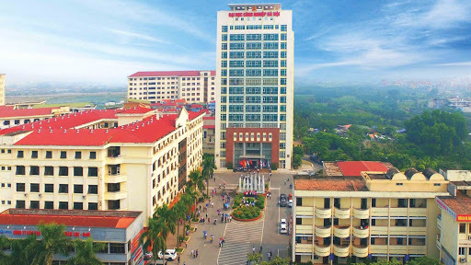

Lots of universities, students
Need a lot of interaction
CAPSTONE1
WHY?

Slide 7
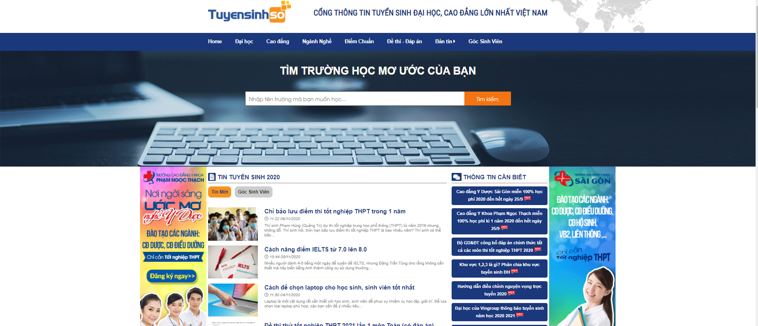
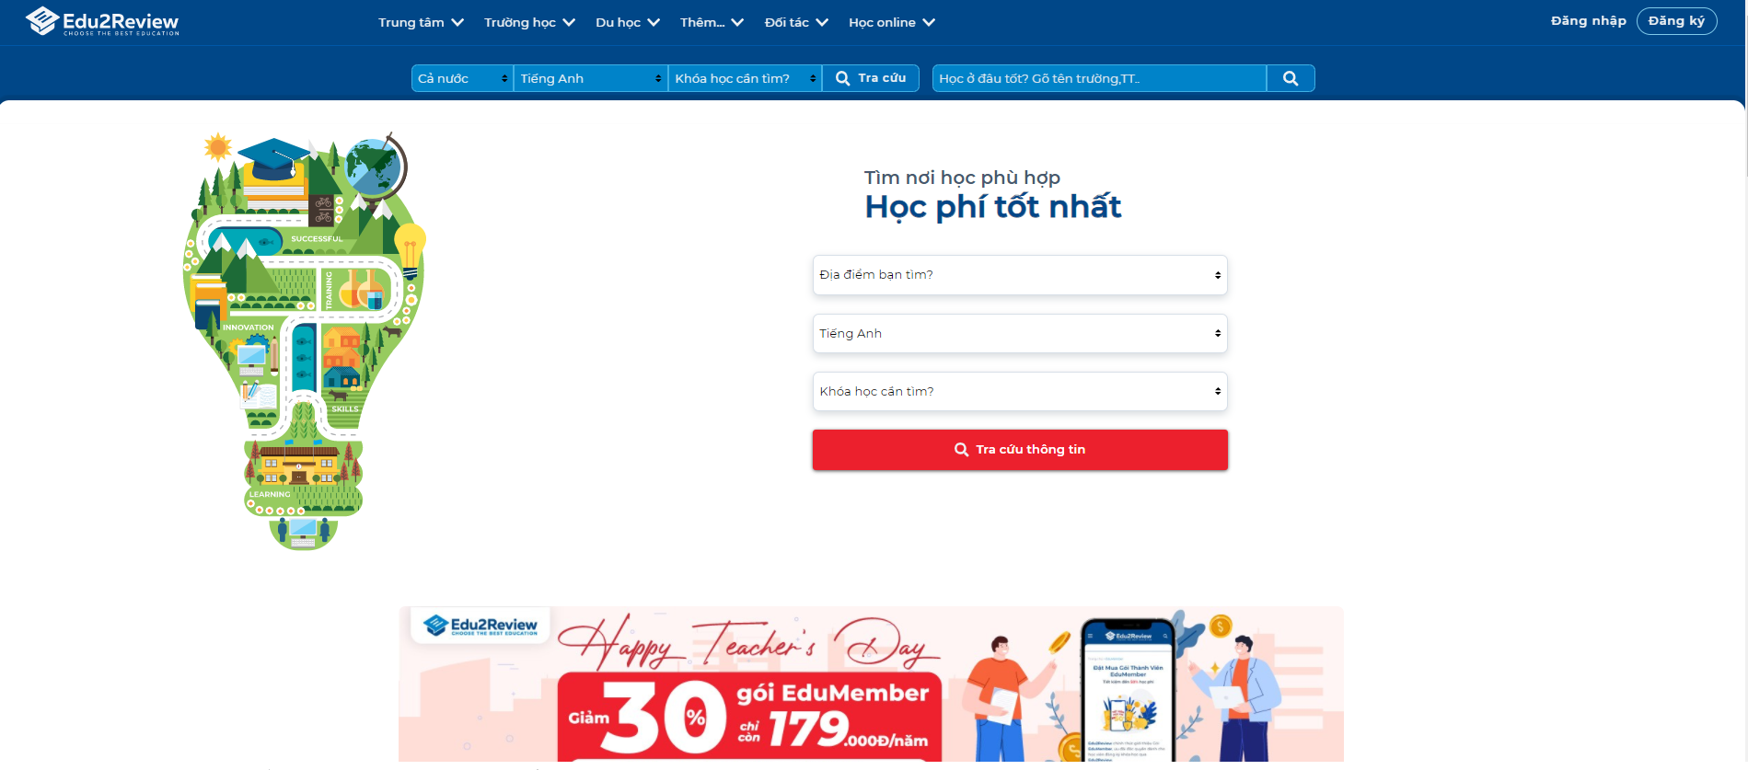
tuyensinhso
edu2review
CAPSTONE1

Slide 8
Who?
Admin
University
User
CAPSTONE1
Manage and control all website content
Fill their information university like their major, their infrastructure …
Watch and interact about the universities they are interested

Slide 9
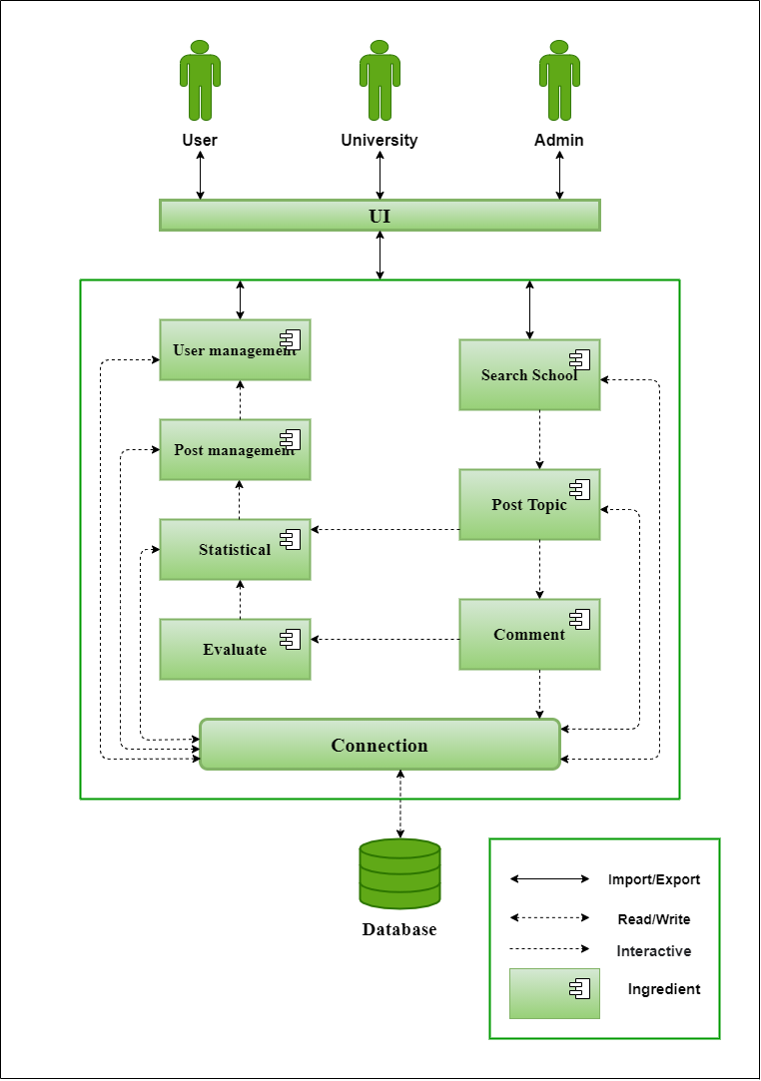
Project Architecture
CAPSTONE1
C & C view

Slide 10
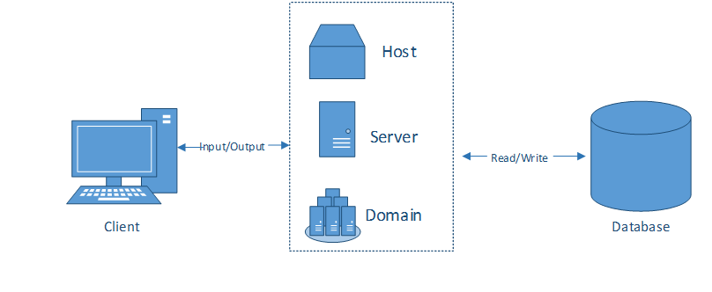
Allocation view
CAPSTONE1
Project Architecture

Slide 11
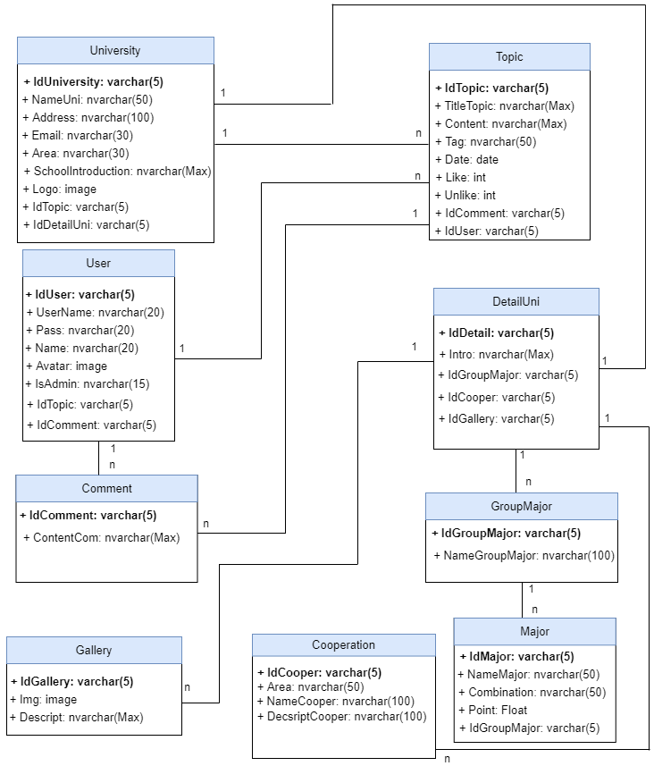
RELATIONSHIP DATABASE
CAPSTONE1

Slide 12
Develop tool
HTML, CSS, JavaSCRIPT
Nodejs
React JS & Material UI
Adobe XD
Mongodb
Github & Trello
CAPSTONE1
Keystone js

Slide 13
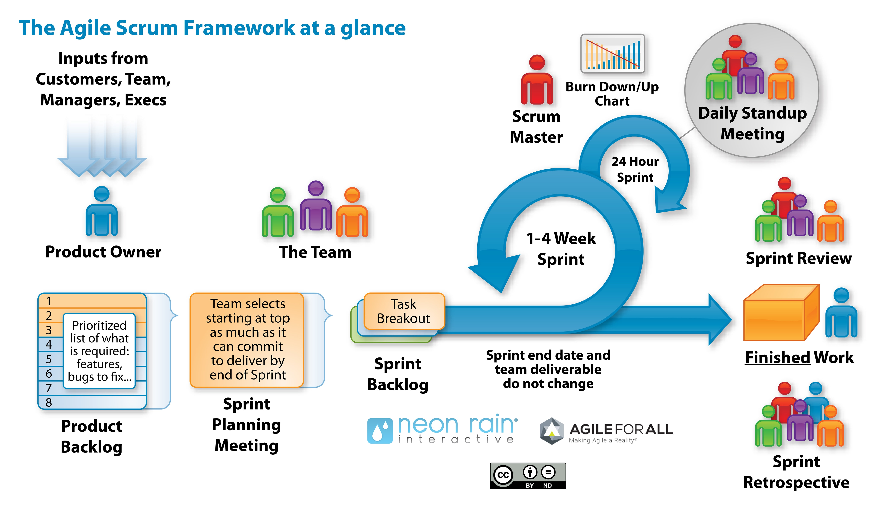
Process Model: Scrum Process
Process model
CAPSTONE1
Scrum is an iterative and incremental agile software development framework for managing software projects and product or application development.

Slide 14
PROJECT PROCESS
CAPSTONE1
ONE
TWO
THREE
Four
SPRINT 1
SPRINT 2
SPRINT 3
SPRINT 4
Start day: 29/08/2020 End day: 25/09/2020
During: 28days
Start day: 25/09/2020 End day: 22/10/2020 During: 28days
Start day: 22/10/2020
End day: 11/11/2020
During: 21days
Start day: 11/11/2020
End day: 01/12/2020
During: 21days

Slide 15
Sprint 1 burndown chart
CAPSTONE1

Slide 16
Sprint 2 burndown chart
CAPSTONE1

Slide 17
Sprint 3 burndown chart
CAPSTONE1

Slide 18
Sprint 4 burndown chart
CAPSTONE1

Slide 19

CAPSTONE1
PRODUCT DEMO

Slide 20
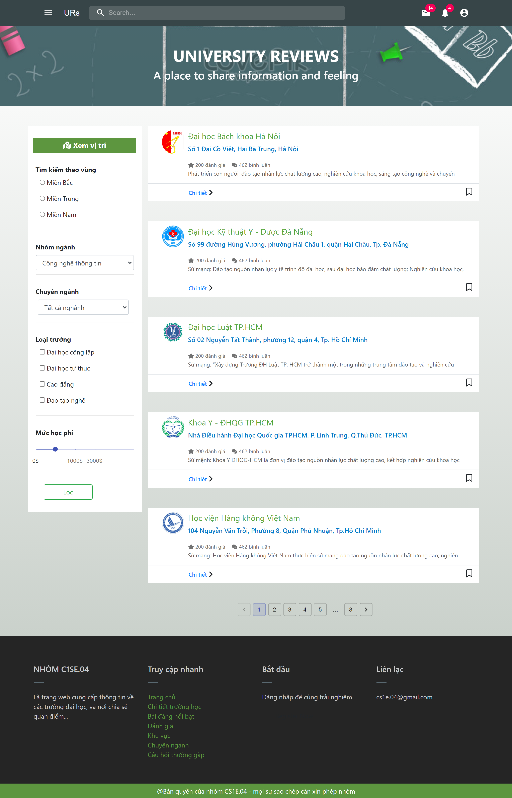
demo

Slide 21
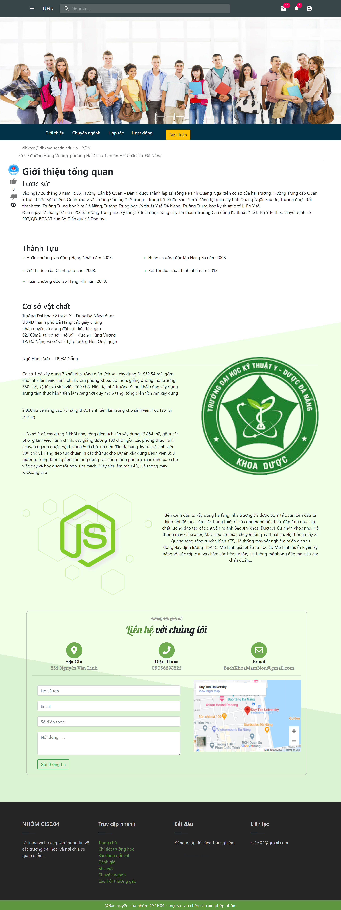
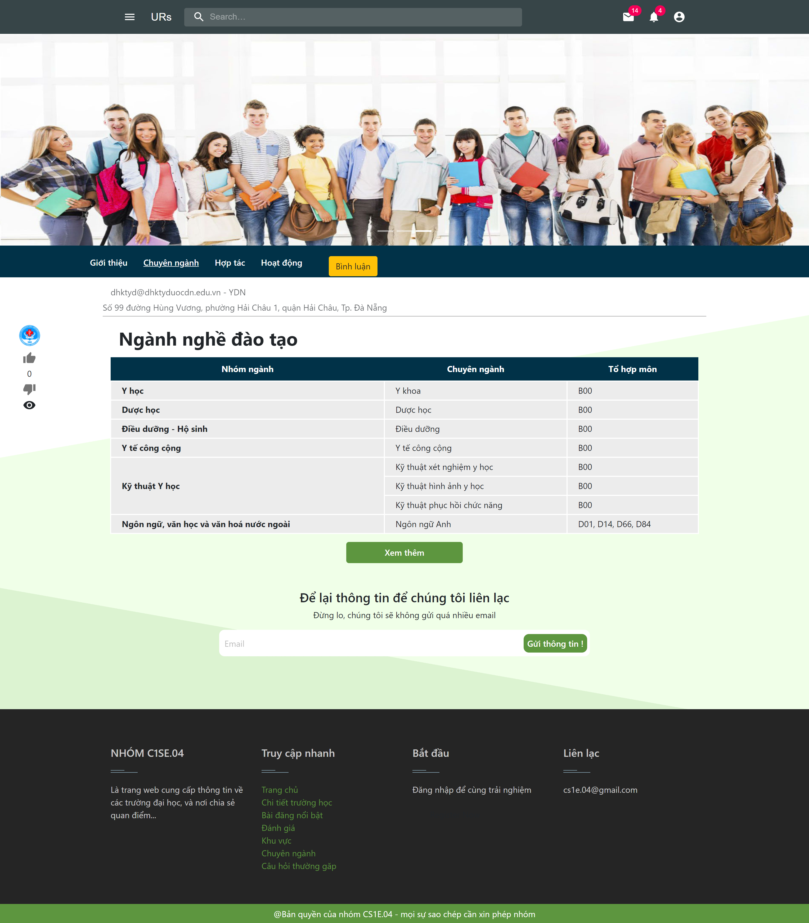
demo

Slide 22
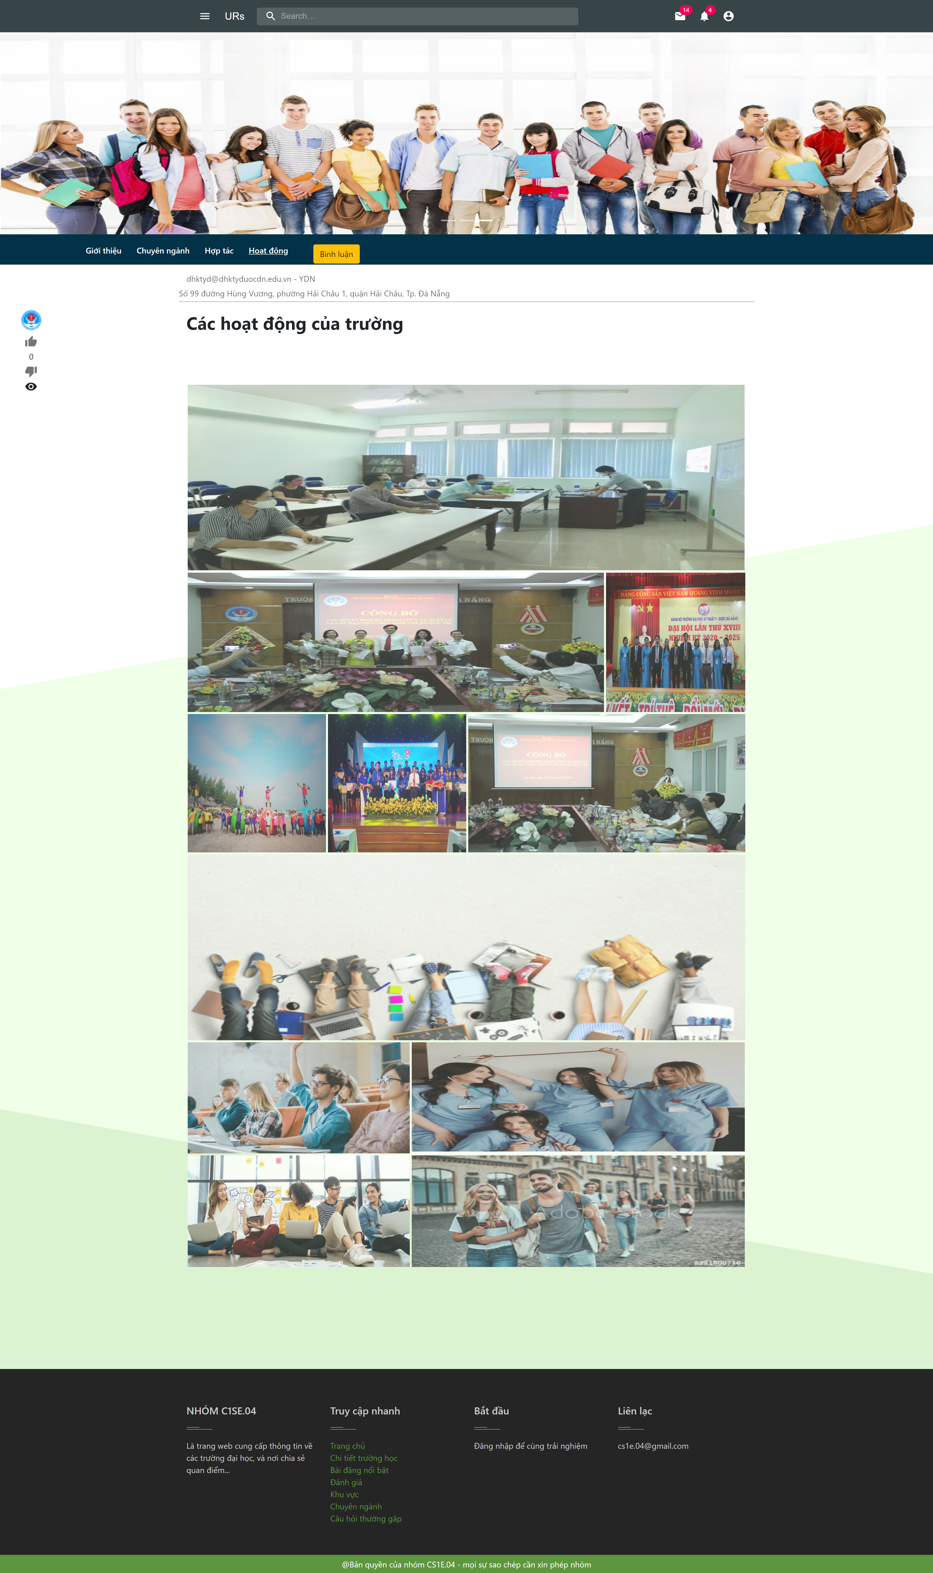
demo

Slide 23
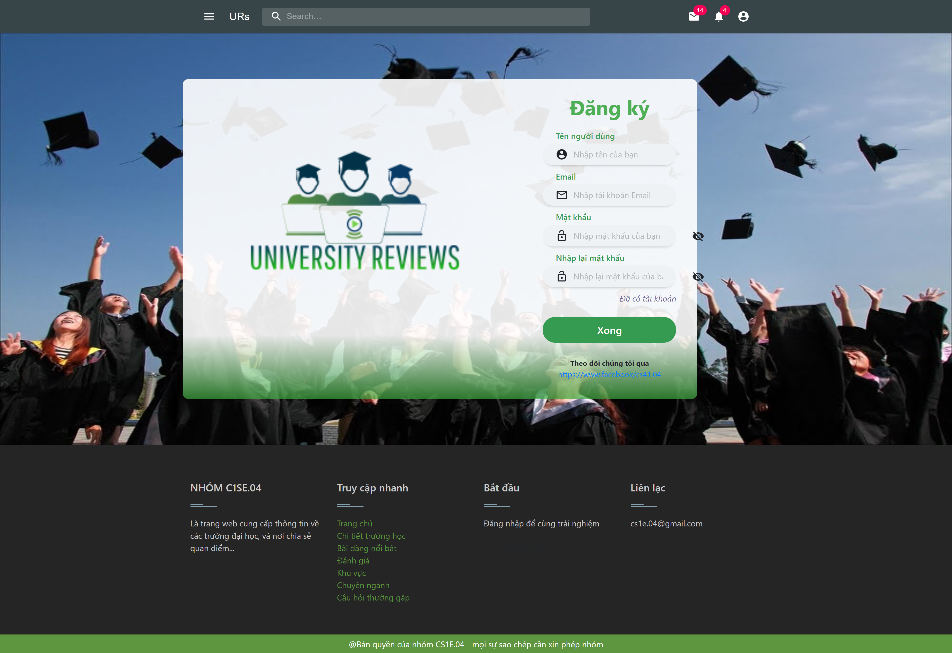
demo

Slide 24
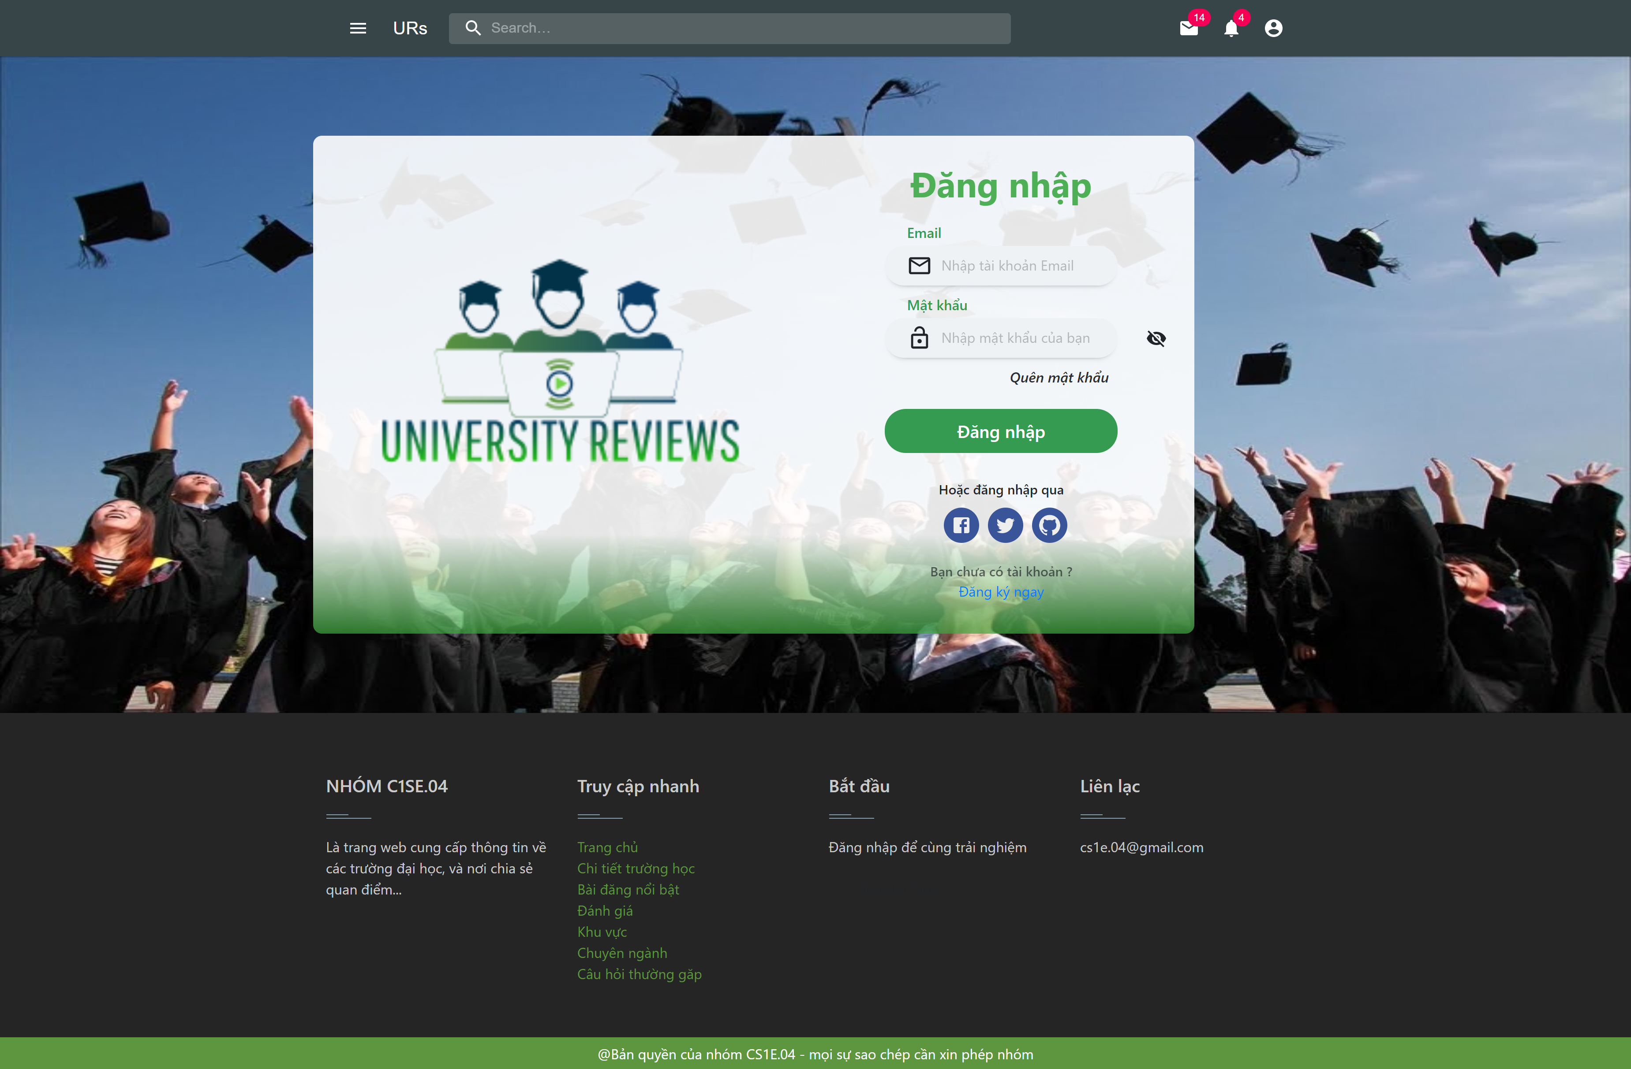
demo

Slide 25
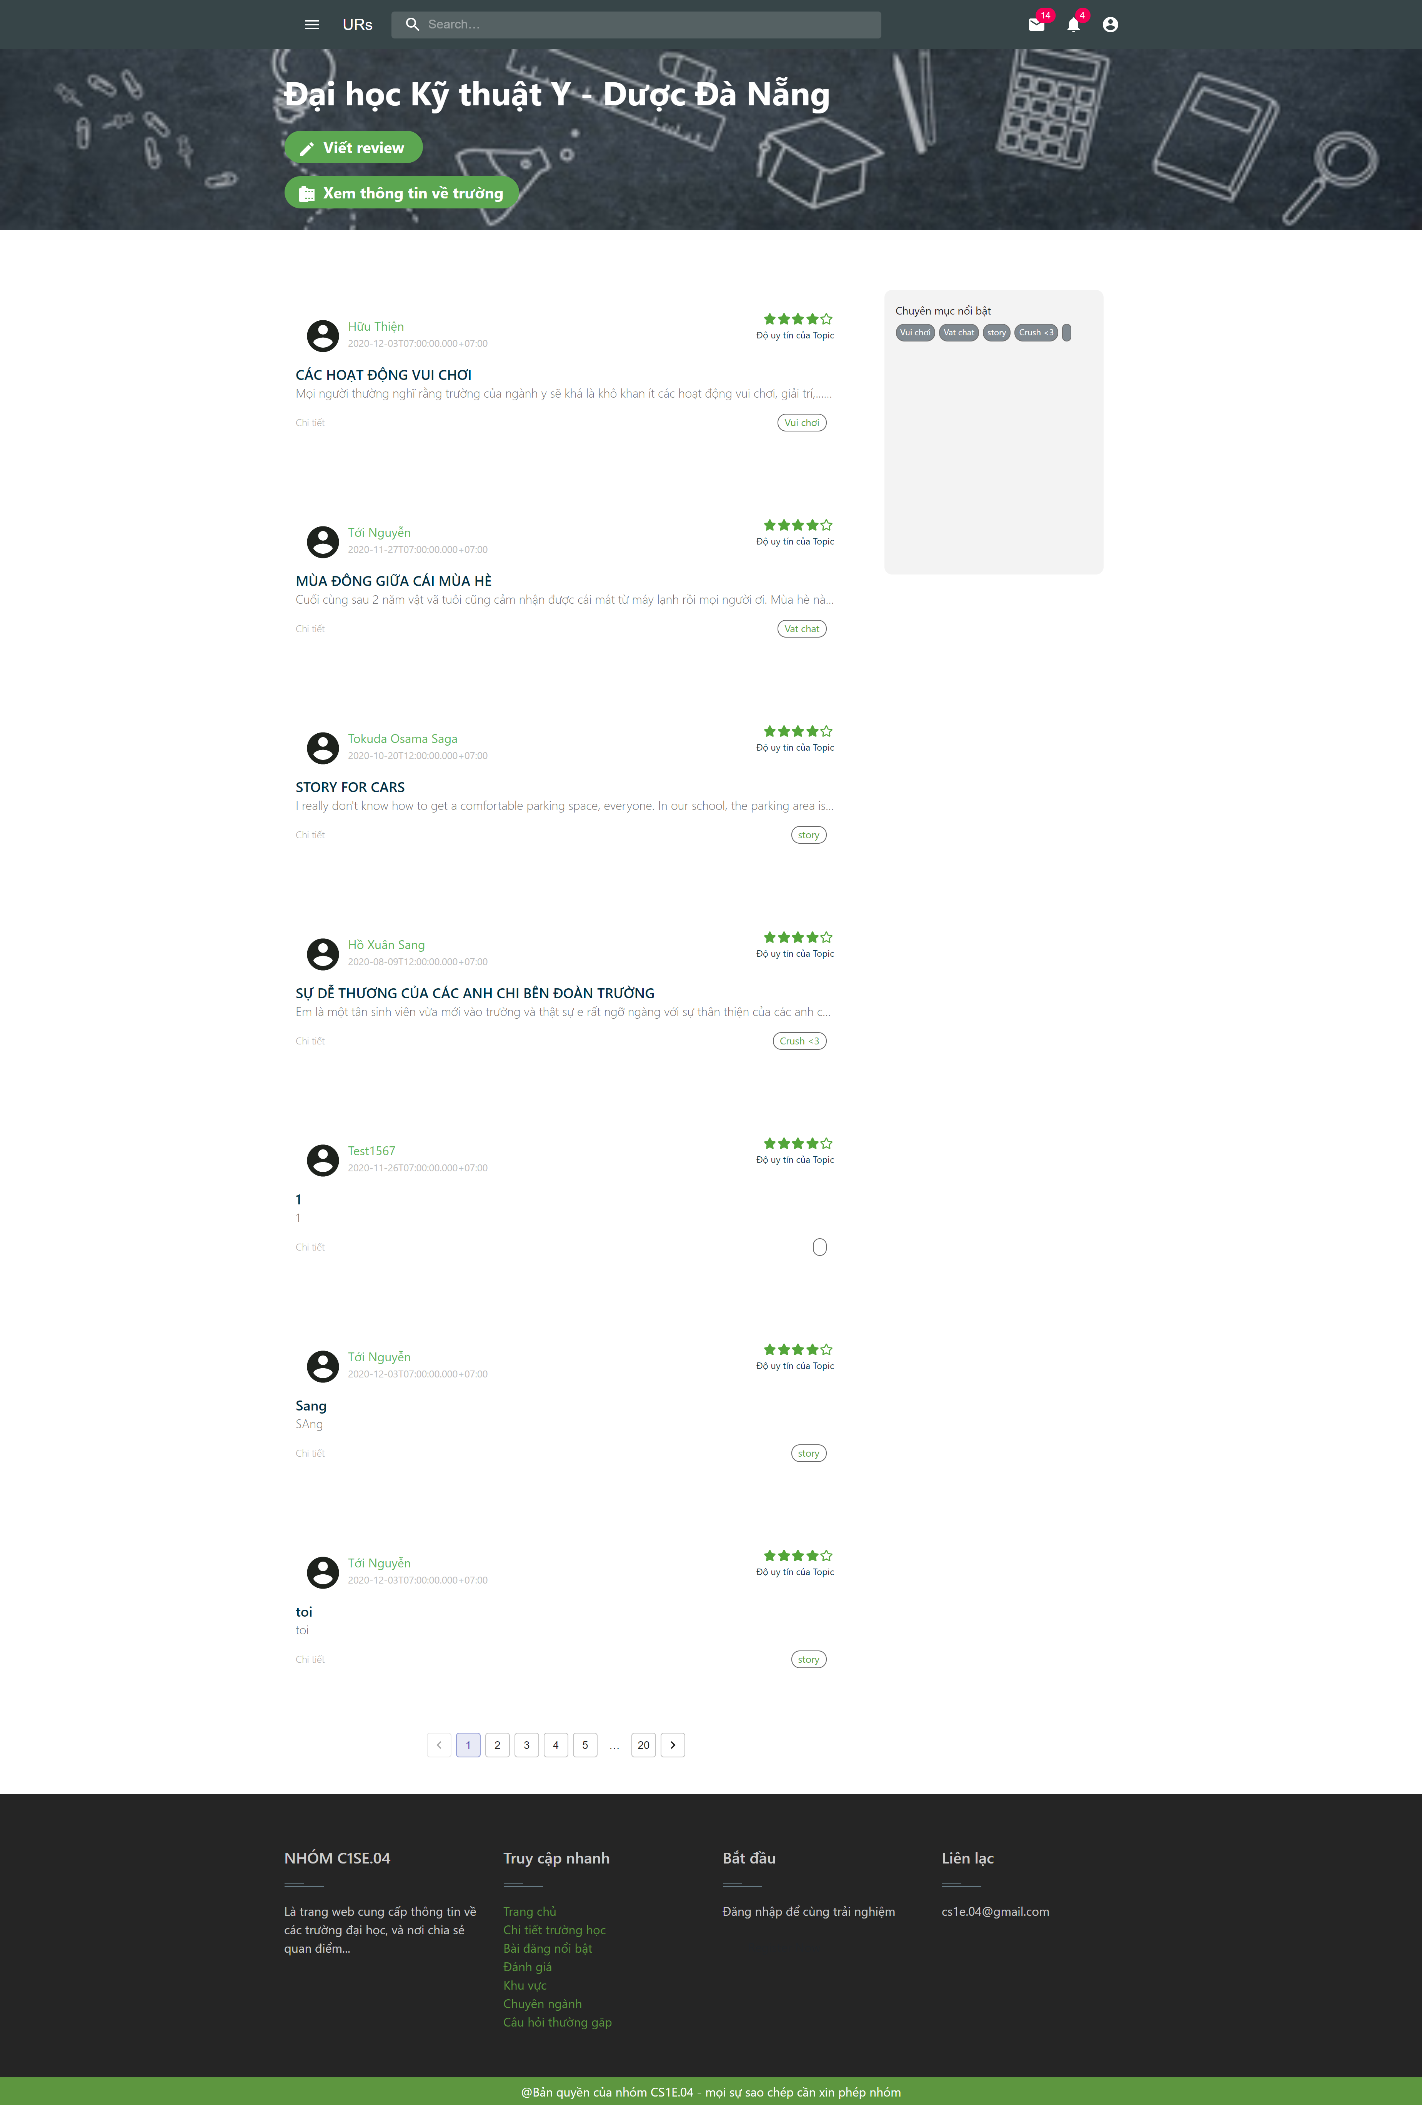
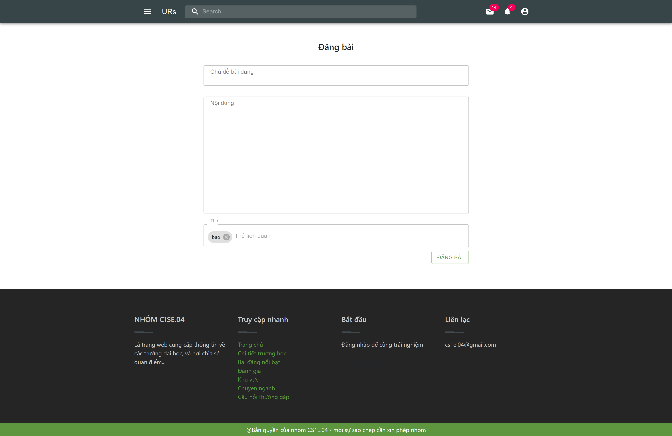
demo

Slide 26
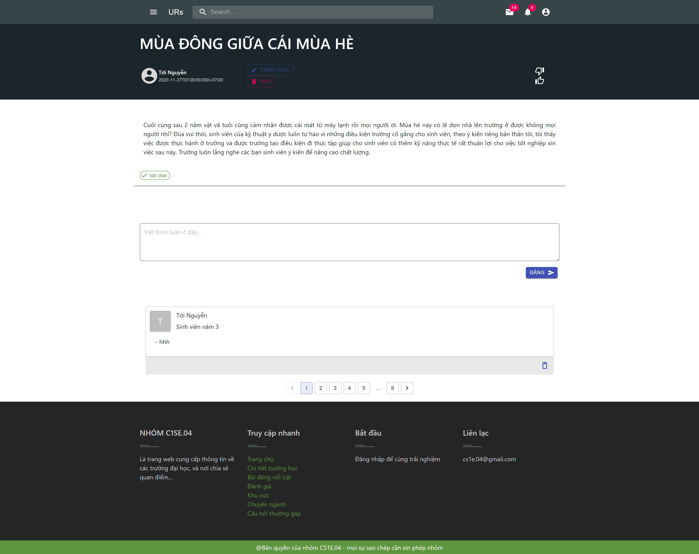
demo

Slide 27
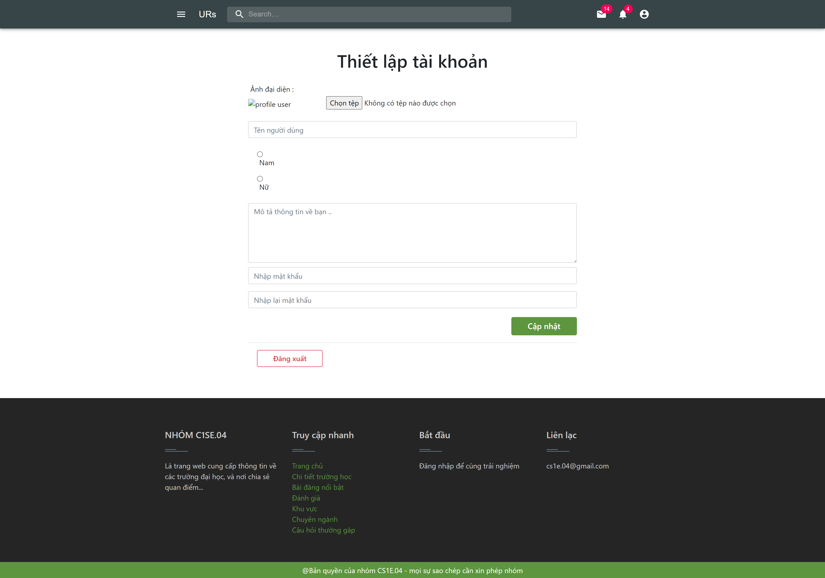
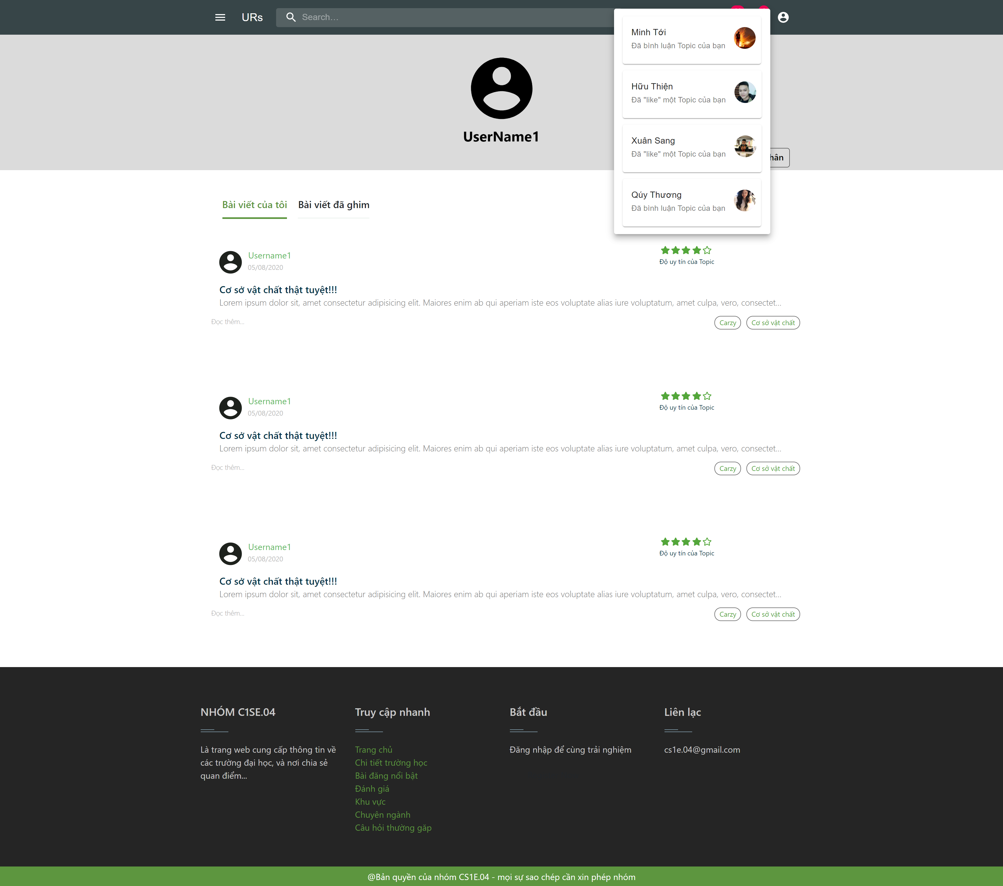
demo

Slide 28



CONCLUISION
100% complete
Learning
difficult
Complete the planned task
New technology
Improve process
Unify ideas and manage time

Slide 29
THANKS for listening
Does anyone have any questions?

Slide 30
Dự phòng

Slide 31
Dự phòng

Slide 32
Allocation view
WORK PROGRESS

Slide 33

Process
Sprint 1
Sprint 2
Sprint 3
Sprint 4
Finished
Finished
Processing
Unfinished

Slide 34
DOCUMENTS
PROPOSAL
SPRINT BACKLOG
PROJECT PLAN
USER INTERFACE DESIGN
USER STORY
DATABASE DESIGN

Slide 35

Problems encountered
Unfinished achitecture documentation
Have not written test documents

Slide 36

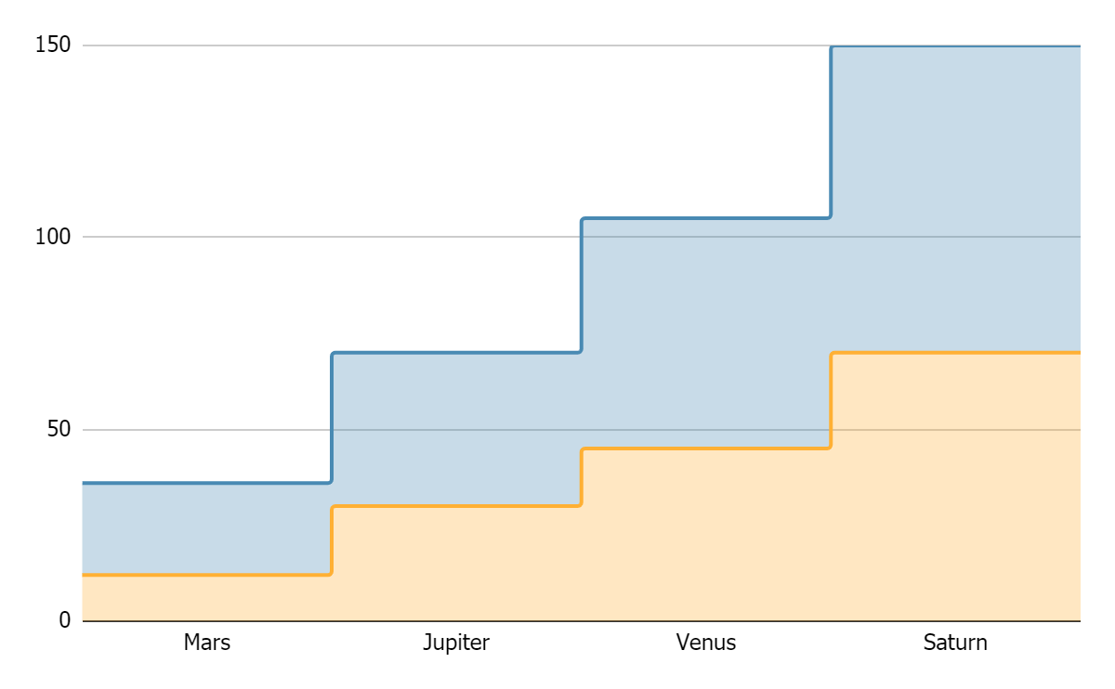
TOPIC DATA
Mercury
Pluto
If you want to modify this graph, click on it, follow the link, change the data and replace it

Slide 37




RECOMMENDATIONS
MARS
VENUS
JUPITER
SATURN
Despite being red, Mars is actually a cold place
Venus has a beautiful
name, but it’s hot
It’s the biggest planet in our Solar System
Saturn is the ringed one
and a gas giant

Slide 38




PRACTICAL EXERCISE
Mercury is the closest planet to the Sun and the smallest one in the Solar System—it’s only a bit larger than our Moon. The planet’s name has nothing to do with the liquid metal, since it was named after the Roman messenger god, Mercury

Slide 39
ALTERNATIVE RESOURCES

Slide 40
RESOURCES
Did you like the resources on this template? Get them for free at our other websites.
VECTORS
People working at the office flat design
Collection of young men and women reading
Set of young men and women reading
Flat business landing page template
People at the office
People at the office
Flat world book day banners
Office workers sitting at desks
PHOTOS
Close-up of woman doing her work
If you want to apply the same filter as the picture included in the template, follow these instructions:
IN GOOGLE SLIDES:
Insert the picture in the slide.
Go to Format options and recolor the picture by applying a black & white filter.
Create a shape with the same size as the picture and fill it with the #ffad802f color.
Place the shape on top of the picture. You can adjust the transparency as you see fit.

